Slide 1
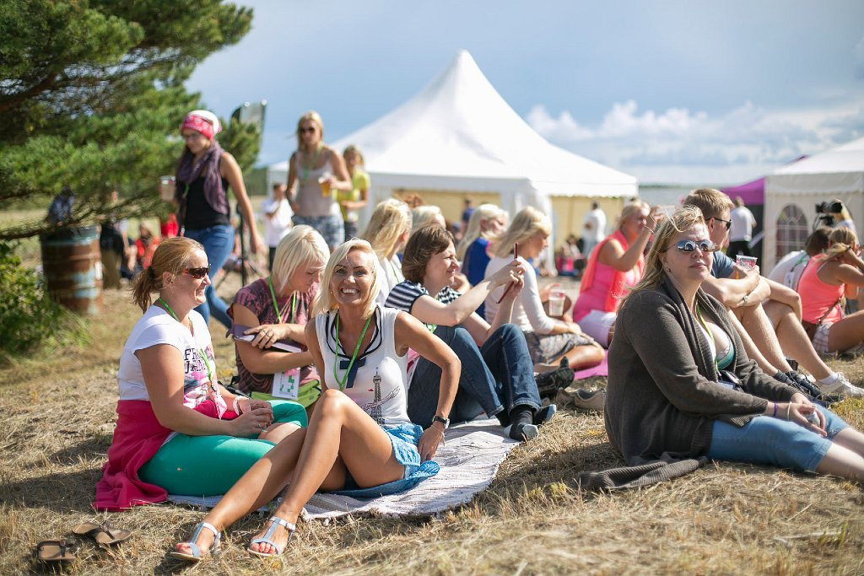
Does culture help to engage employees?
Triin Toome
Notes:
In SEB we have done a lot of different initiatives to engage and also encourage employees.
Today I will share some examples and thinking behind them. Those examples are mostly from last few years. Because some VHS movies from ten or even more years ago would look to funny in today’s context.

Slide 2
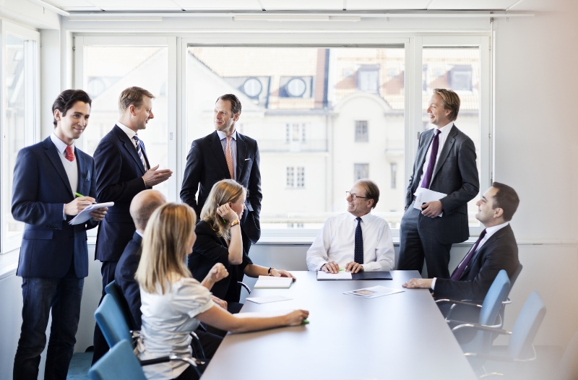
Who works in SEB?
Notes:
Who are they?
Do all 1100 bankers look like that?

Slide 3
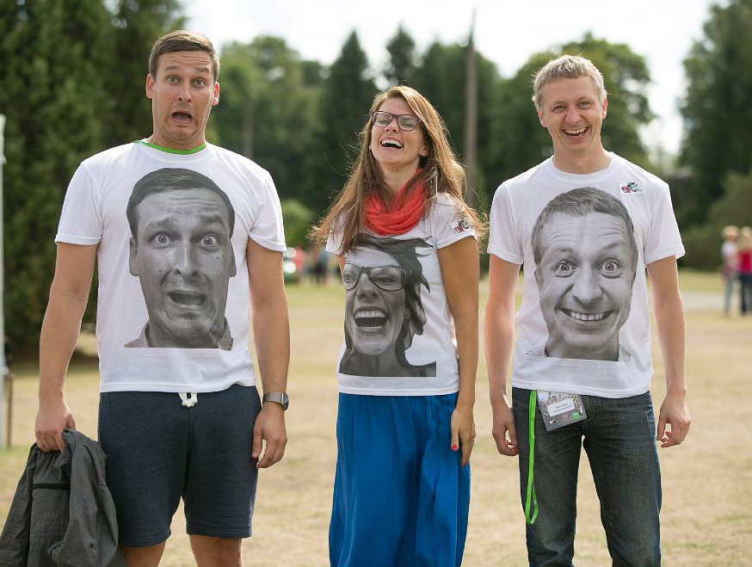
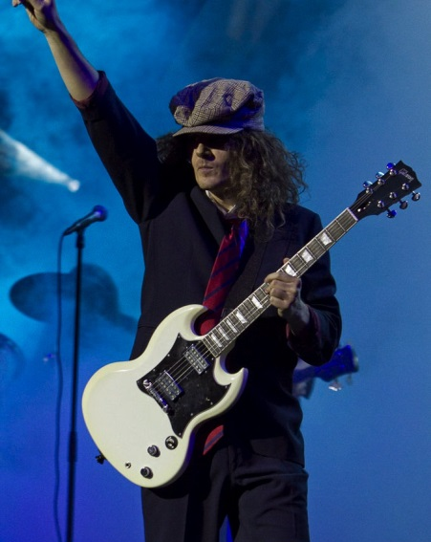
Is there something more?
Notes:
Actors, artists, singers, dancers, athletes, fashion designers and really – just some regular people who want to have fun.
To be honest – it’s not always easy to be creative in your work. But solving creative tasks together unites teams and helps to think outside of box. Or lose the box at all.

Slide 4
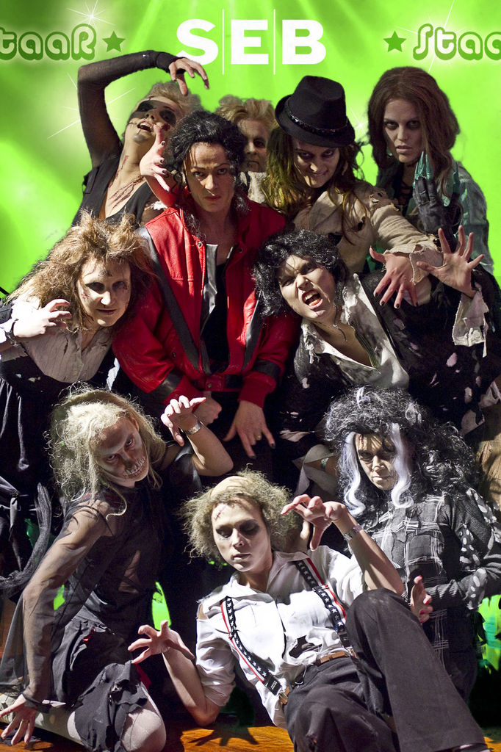
What we do?
Clear goals
Good idea
Engagement
Internal communication targets
Fun
Three types of regular events
New Years events
Events and initiatives to improve business culture and organisation culture
Summer festivals
Notes:
For the events we set always clear goals
The idea has to be good
There has to be engagement – always – the more the better
Our aim is to set some internal communication targets
And last but not least – it has to be fun!
There are three types of regular bigger events I’m going to introduce today.

Slide 5
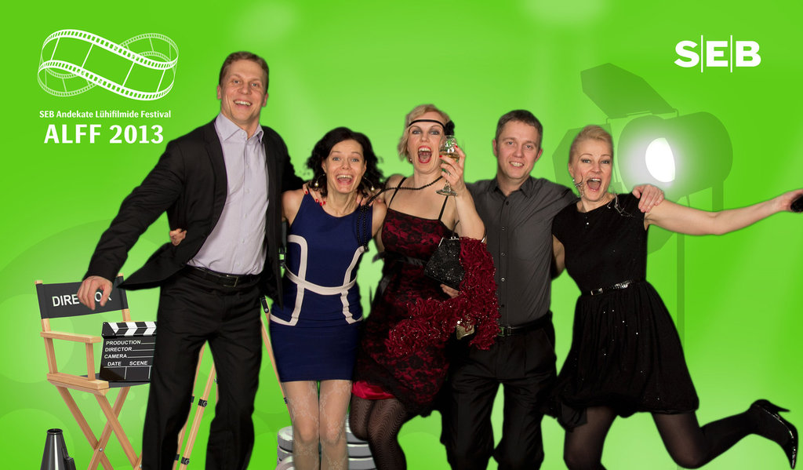
New Years events
Andekate Lühifilmide Festival - Movie Festival
Moemaja - Fashion Show
Dance Festival
SEB Star - Playback show
TV show - Game Show
Opera
Singing with Stars - coming up on this Saturday
Notes:
Some examples of what kind of events we have done.
While talking about goals or targets - Movie Festival topic was horisontal career, in Dance Festival we used 10 point business plan etc.
But engagement and number of participants has always been top priorities. And during last 5-6 years around 90% of employees has been participating in the events each year and around 200 employees has been participating in preparations, competitions etc. And we are always aiming to get the attention of different targetgroups.

Slide 6
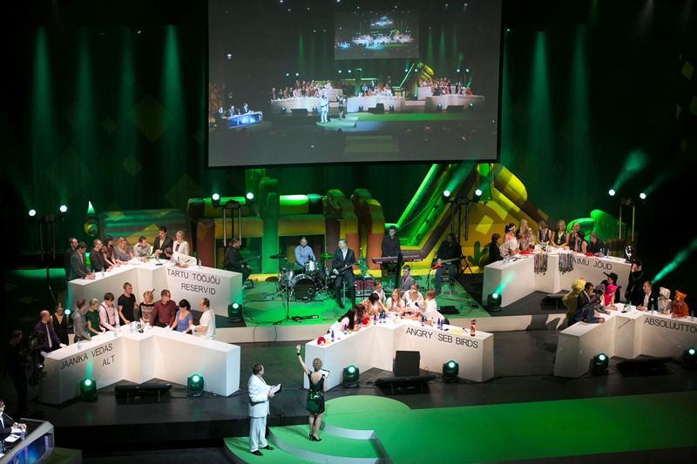
Game Show
More than 300 employees involved
Activities from November to January
Participants from all over the country
Competitions led by area professionals
Notes:
Game Show video

Slide 7
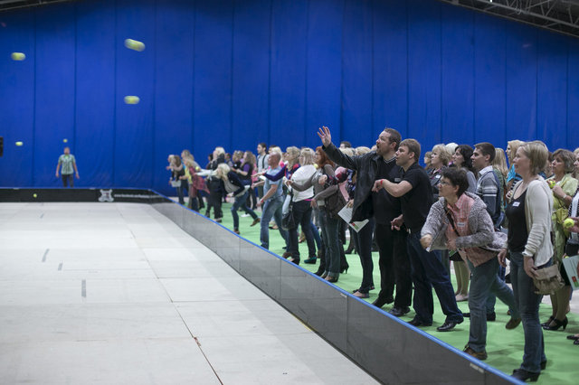
Educating employees
Events and initiatives to improve business culture and organisation culture
Home Bank Day
Employee LAB
Corporate Sustainability Day: „Your contribution to the Future!“
etc
Notes:
Other tradition is to have bi-yearly strategical events to improve business culture and organisation culture.
Employee LAB – is SEB’s own new innovation project. Thru LAB initiative we involve employees into development process using innovation and start-up methodologies and tools.
Let’s see the video about CS Day

Slide 8
Summer events
Notes:
I will show you a video about our summer event three years ago. Guiness video.

Slide 9
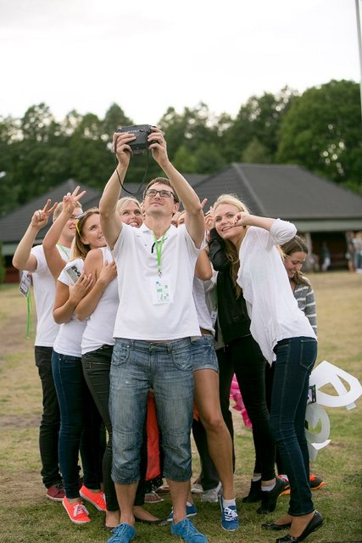
(How) does it works?
It’s been a journey!
All challenges accepted
Success factor
Employees get as good quality as the best customers
Brand and core values
Long term partnership
Notes:
Using the help of culture and creativity we have been encouraging employees to do things they wouldn’t dream of. From creating fashion collection to performing on stage with Genka or Liis Lemsalu.
It is been a journey! This kind of experiences and stepping out of comfort zone from year to year – it has been teached employees to accept bigger challenges also in work areas.
It has also teached about success factor and how to be the best. Employees in SEB believe that everything is possible☺
Whatever is the topic we never lose SEB-s brand, core values or true identity.
- We have been using the same event organiser already many years – together we have kept traditions and also break traditions where needed. It pays off.

Slide 10
Notes:
And one thing we changed…
As mentioned before – the aim is always to educate employees and improve culture. But last year we changed the concept of summer event – and we organised just Summer Festival – the festival with three stages, beach area and five different artists. This kind of festival what everybody would want to visit during summer.
Just to give you some of the feeling from our Summer Festival I will end my presentation with this video. Suvefestivali video

