Slide 1
EU4Business:
Connecting Companies
Ana Sarateanu
Senior Project Officer

Slide 2
Background
EU4Business:
Connecting Companies
Duration
The project is managed by EUROCHAMBRES and funded under the EU4Business initiative of the European Union
The project builds upon the positive results of the successful East Invest projects implemented by EUROCHAMBRES (2010-2017)
December 2019 – December 2022
Overall objectives
Promote trade between the EU Member States and the 6 Eastern Partnership (EaP) countries
Sustainable economic development and job creation in the EaP countries by helping SMEs to grow
Beneficiaries
BSOs and SMEs from the 6 Eastern Partnership countries (RA, AZ, BY, GE, MD, UA)

Slide 3
Helping SMEs to grow means
EU4Business:
Connecting Companies
Promote increased trade
Encourage inward investments
Foster business links with companies in the EU
HOW?

Slide 4
Twinning definition
EU4Business:
Connecting Companies
Capacity Building and Coaching
Peer to peer learning and coaching (in support of the development of a new service)
Exchanges of best practices (in support of the development of a new service)
Some clarifications
B2B Matching
Preferably on the “filière” (i.e. supplier and producer, producer and re-seller, etc.)

Slide 5
Sectors
EU4Business:
Connecting Companies
WINE

Slide 6
Sectors
EU4Business:
Connecting Companies
ORGANIC/BIO-FOOD

Slide 7
Sectors
EU4Business:
Connecting Companies
TOURISM

Slide 8
Sectors
EU4Business:
Connecting Companies
TEXTILES

Slide 9
Sectors
EU4Business:
Connecting Companies
CREATIVE INDUSTRIES
The creative industries sector is also referred to as the ‘creative and cultural industries‘ or the ‘creative and digital industries‘ or the ‘creative industry‘ within the ‘creative economy‘.
Link: https://www.davidparrish.com/creative-industries-definitions/

Slide 10
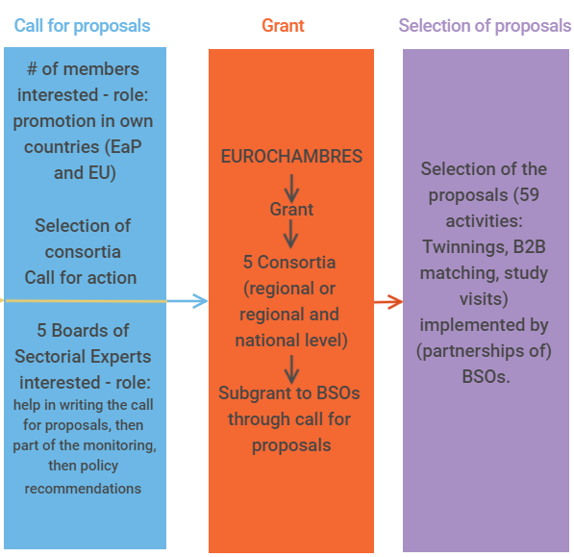
EU4Business:
Connecting Companies
The process

Slide 11
EU4Business:
Connecting Companies
EUROCHAMBRES, DG NEAR and the sectorial experts will select the 5 consortia for 5 sectors (upon the base of applications and selection grid)
Therefore there will be 5 sectors covered each by a selected consortium
Each consortium will launch her own call for proposals for a certain number of implemented actions
Each implemented action will have a budget of max. 60.000,00 euro (95% financed, no indirect costs)
There will be a max. number of twinnings to be granted, a max. number of study visits and a max. number of B2B matches to be granted
National Chambers will have a role in the promotion of the call at national level
The process

Slide 12
EU4Business:
Connecting Companies
March – May 2020 – visits of the Team Leader to the EaP countries
May 2020 – call for proposals issued by EUROCHAMBRES for the selection of consortia
End June 2020 – deadline for submitting the proposals
September 2020 – results
October 2020 – consortia starting the activities
January 2021 – consortia calls for proposals for the implementation of the activities
February 2021 – results
March 2021 – starting the implementation of the activities
Indicative Timeline

Slide 13
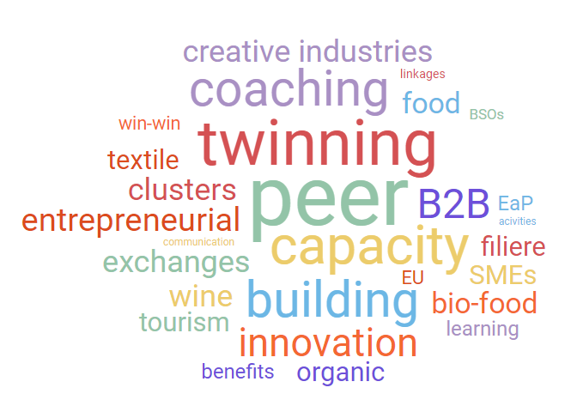
Follow us on:
Facebook - @EU4BCC
LinkedIn - EU4Business: Connecting Companies
Twitter - @EU4BCC

Slide 14
Thank you for your attention!
And please spread the word
about the project
For more information:
eu4bcc@eurochambres.eu

